Slide 1


Intelligent Fraud Prevention in Credit Card Transactions
Presented by
Md. Shakil Hossain - 1061

Slide 2

Overview
Introduction
Literature Review
Data Description
Data Analysis
Methodology
Conclusions

Slide 3


Introduction
Problem statement
The increasing prevalence of credit card fraud in the digital era necessitates the development of robust and efficient fraud detection systems. This project aims to develop a machine-learning model to detect credit card fraud. The model will be trained on a dataset of historical credit card transactions and evaluated on a holdout dataset of unseen transactions.
Project Goal
The main aim of this project is the detection of fraudulent credit card transactions, as it is essential to figure out the fraudulent transactions so that customers do not get charged for the purchase of products that they did not buy.
Research question
What machine learning model is most suited for detecting fraudulent credit card transactions?

Slide 4
Literature Review
•The model used by Alenzi and Aljehane to detect Fraud in credit cards was Logistic Regression. Their model scored 97.2% in Accuracy, 97% sensitivity and 2.8% Error Rate.
•Dighe and his team used KNN, Logistic Regression and Neural Networks, multi-layer perceptron and Decision Tree in their work, then evaluated the results regarding numerous accuracy metrics. Of all the models created, the best performing one is KNN, which scored 99.13%, then in second place performing model at 96.40% and in the last area is logistic Regression with 96.27%.
•Sahin and Duman used four Support Vector Machine methods in detecting credit card fraud. (SVM) Support Vector Machine with RBF, Polynomial, Sigmoid, and Linear Kernel, all models scored 99.87% in the training model and 83.02% in the testing part of the model.

Slide 5
Dataset
This dataset contains credit card transactions made by European cardholders in the year 2023. It comprises over 550,000 records, and the data has been anonymized to protect the cardholders' identities. The primary objective of this dataset is to facilitate the development of fraud detection algorithms and models to identify potentially fraudulent transactions.

Slide 6

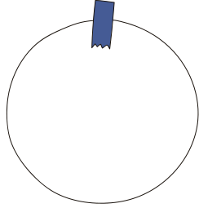

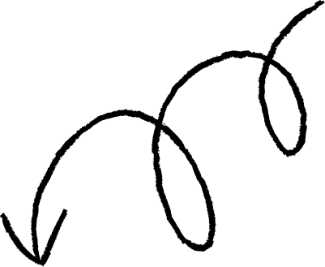
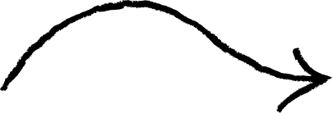



Data Description
Time
Amount
Data Description
•which contains the elapsed seconds between the first and other transactions of each Attribute.
•Which is the amount of each transaction
•The dataset was retrieved from an open-source website, Kaggle.com. It con- tains data on transactions made in 2013 by European credit card users in two days only. The dataset consists of 31 attributes and 284,808 rows.
Class
•which contains binary variables where 1 is a case of fraudulent transaction, and 0 is not as case of fraudulent transaction.
•Twenty-eight attributes are numeric variables that, due to the confidentiality and privacy of the customers.

Slide 7
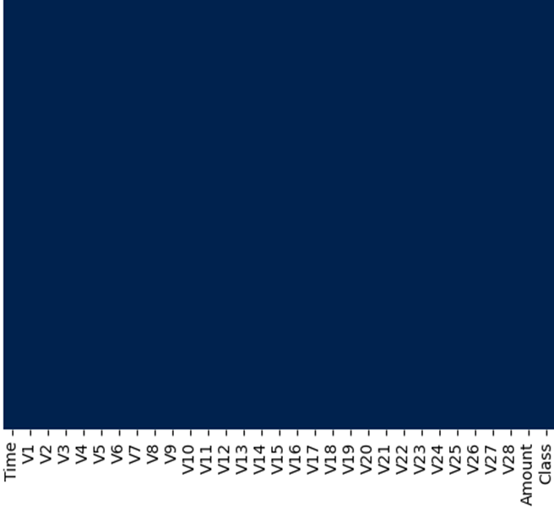
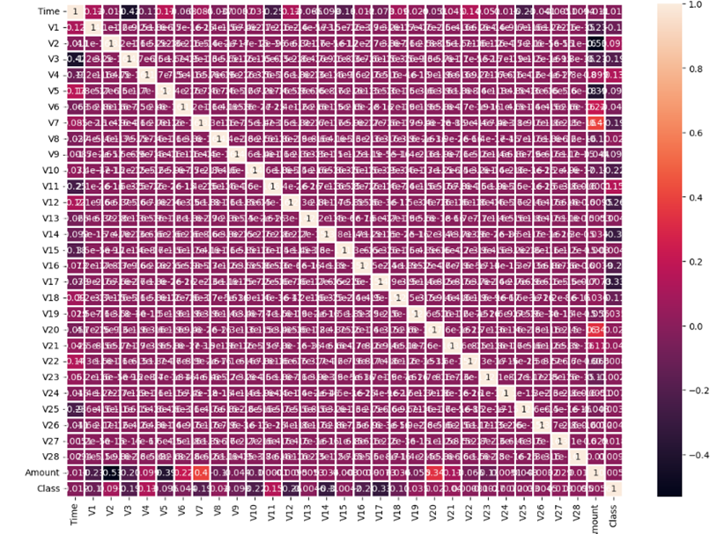
Data Analysis
Check Null Data
Data Correlation

Slide 8





Methodology
Data Collection
Data Cleaning
Normalization
Model Training
Model Evaluation
The first phase will involve collecting a dataset of historical credit card transactions. The data will be collected from various sources, including banks, credit card companies, and
merchants.
•Impute the missing values with the column's mean, median, or mode.
•Drop the rows with missing values.
•Use a machine learning model to predict the missing values like isnull() and heatmap().
Normalization is scaling the data so that all features have similar values. This can
improve the performance of machine learning models by making the parts more
comparable.
The second phase will involve training the machine learning model on the collected data.
The model will be prepared using a supervised learning algorithm like SVM.
The third phase will involve evaluating the machine learning model's performance on aholdout dataset of unseen transactions. The model's performance will be evaluated using accuracy, precision, and recall metrics.

Slide 9
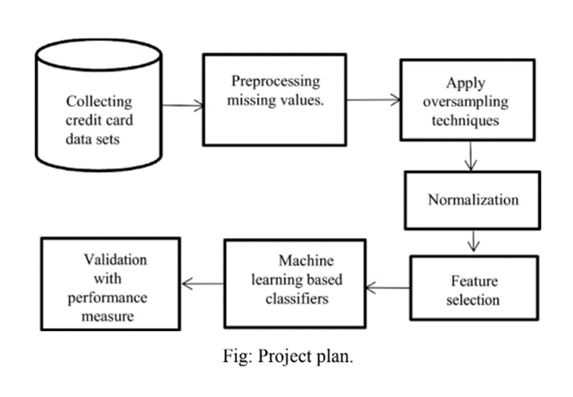
Continue...

Slide 10
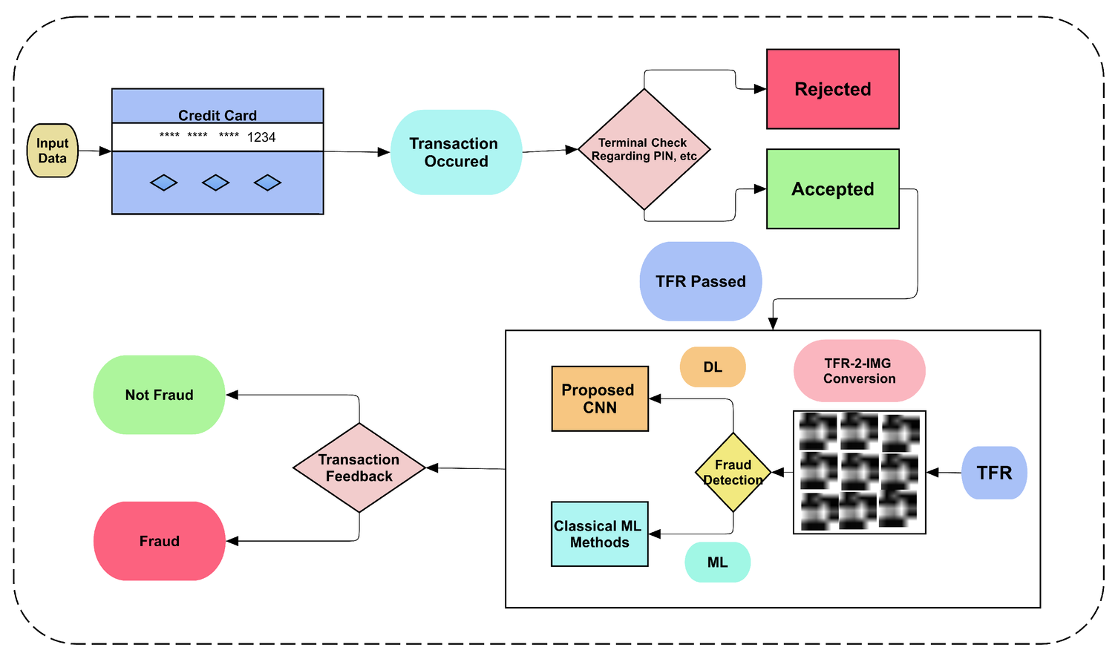
Continue...
Figure: Flowchart of of proposed framework

Slide 11
Conclusion
In conclusion, the main objective of this project was to find the most suited model for creditcard fraud detection in terms of the machine learning techniques chosen for the project. It was met by building the four models and finding the accuracies of them all; the bestmodel in terms of accuracies is KNN and Decision Tree, which scored 100the amount of credit card fraud and increase the customer’s satisfaction as it will provide themwith a better experience and feeling secure.

Slide 12
Any Questions?

